Slide 1
College and Career
Master Plan Update
May 21, 2019

Slide 2
Agenda
The purpose of tonight’s presentation is to provide the board a status update on the College and Career Readiness (CCR) Master Plan.
Topics Include:
1. Master planning process
2. Preliminary listening campaign data
3. Preliminary labor market data
4. Preliminary pathway data
5. Components of quality college and career pathways

Slide 3
Master Plan Initiative: Goals
Develop an Implementation Plan making CTE an integral part of high school improvement
Undertake a district-wide needs and capacity assessment
Strengthen capacity of district and site leadership to effectively design and implement college and career pathways
Define key metrics for assessing progress and supporting continuous improvement

Slide 4
Bringing the Vision to Life
ConnectEd and College & Career Pathways will help to operationalize:
Portland Public Schools High School Strategic Plan
Graduate Profile developed by Prospect Studios

Slide 5
Compelling Change Data: Graduation Rates

Slide 6
High school is not working for very large numbers of young people

Slide 7
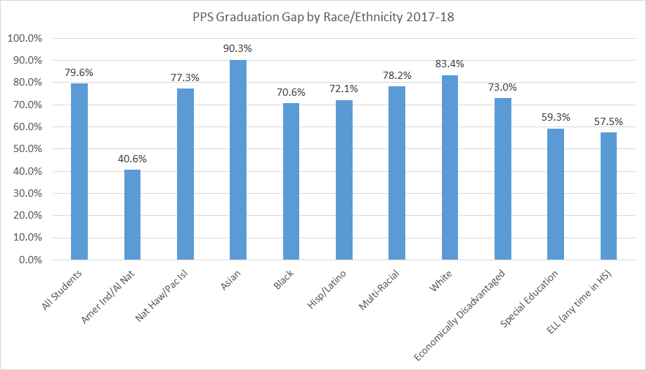
PPS Race/Ethnicity Gap
Notes:
-this data shows our achievement gap persists.

Slide 8
PPS CTE Graduation Rates Students completing 1 credit in CTE
 | 2011-12 | 2012-13 | 2013-14 | 2014-15 | 2015-16 | 2016-17 | 2017-18
PPS District Graduation Rate | 63.0% | 67.0% | 70.0% | 74.0% | 75.0% | 76.0% | 79.6%
PPS District CTE Graduation Rate | 84.0% | 87.0% | 89.0% | 91.0% | 90.0% | 89.0% | *98.6%
Subpopulations:
- American Indian | 76.0% | 54.0% | 80.0% | 83.0% | 100.00% | 100.0% | *100.0%
- Asian | 97.0% | 96.0% | 94.0% | 99.0% | 97.0% | 96.0% | *100.0%
- African American | 75.0% | 76.0% | 87.0% | 94.0% | 93.0% | 86.0% | *97.3%
- Hispanic | 83.0% | 88.0% | 93.0% | 88.0% | 85.0% | 88.0% | *98.3%
- White | 82.0% | 87.0% | 91.0% | 89.0% | 81.0% | 90.0% | *98.9%
*Includes modified diploma students

Slide 9
More math, science, English, and social studies without relevance won’t engage today’s students

Slide 10
Strong career and technical education alone can’t produce career success

Slide 11
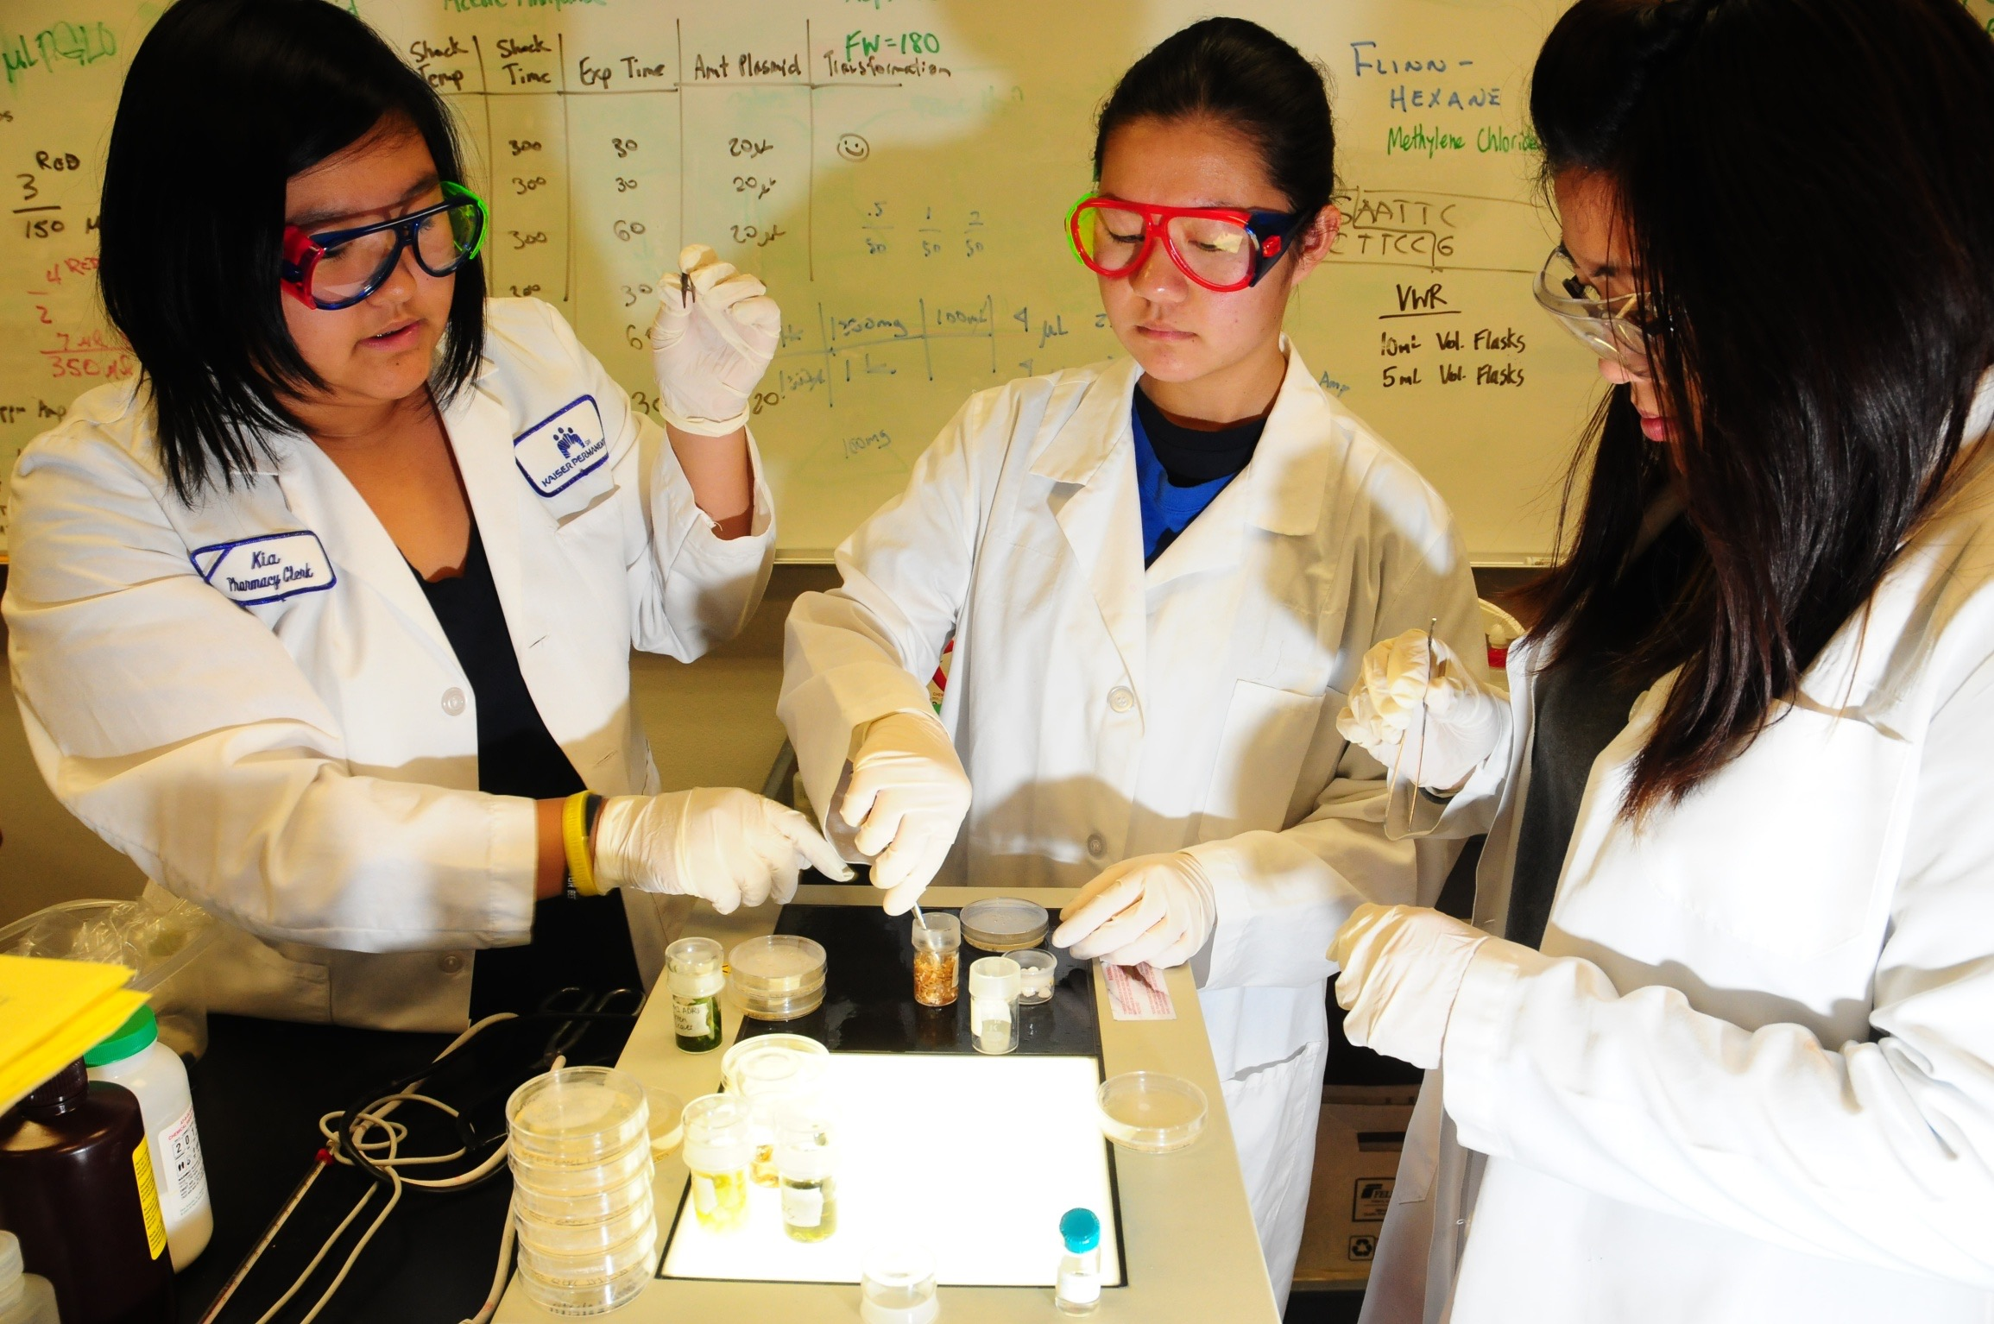
We need a new approach: pathways that prepare students for both college and career

Slide 12
Where We are in the Process

Slide 13
Timeline- what we have done
September 2018 | Clarified the district need, wrote up a scope of work, and began the RFP process
November 2018 | Contract negotiations with ConnectEd
December 2018 | Board approval to begin the partnership with ConnectEd
January 2019 | First visit of ConnectEd for scope and role clarification, listening campaign, staff orientation
February 2019 | Second site visit (snow days!), Third ConnectEd site visit- collection of qualitative data from stakeholders
March/April 2019 | Compile labor market data, compile pathway and student participation data
May 2019 | Board update and starting the process of using qualitative and quantitative data to clarify district needs and strengths

Slide 14
Timeline- what is next
Week of June 10th 2019 | Proposed first Advisory Group meeting to orient members to the process and next steps
June 17th 2019 | Summary reports on data collection and analysis submitted for review to ConnectEd
July/August 2019 | Proposed second Advisory Group meeting to review draft of the master plan and provide input
September 2019 | Proposed third Advisory Group meeting to review final draft of the master plan
October 2019 | Submit master plan
November 2019 | Submit implementation plan
Between January 2019 and April 2020 | Cohort 1 Pathway Design Institute

Slide 15
Process: Current Status
Linked Learning Overview
Introduce the guiding principles of a high quality College and Career Readiness program
Answer any questions about the main components and concepts
Listening Campaign
Meet with all stakeholders to hear “hopes & concerns”
Pathway Data Analysis
Review pathway data to understand current offerings, enrollment patterns, and geographic locations across the city
Review pathway data to understand recent changes in offerings
Remaining Groups: core content teachers, parent & student community representatives, Facilities Department
Notes:
Add dates
Change District to “no caps” – district

Slide 16
Process: Current Status
Labor Market Analysis
Review preliminary local, state and national labor market data
Determine Project Leadership
Identify leadership team and leadership roles for the work
Needs and Capacity Assessment
Identify appropriate team to review district critical conditions and draft an aligned action plan
Remaining steps: Identify appropriate sites to review pathway essential elements and draft an aligned action plan
Remaining steps: Determine stakeholder advisory group for the work and calendar meetings
Remaining steps: Determine local industry and labor market trend areas and assess current pathways aligned with trends.

Slide 17
Process: Current Status
Facilitate Advisory Council
Remaining Steps: Convene advisory council to review data and articulate recommendations
Remaining Steps: Review master plan drafts and provide recommendations
Draft Guiding Plans
Remaining Steps: Review final data collections, needs & capacity assessments
Remaining Steps: Draft final master plan and implementation plan

Slide 18
Listening Tour Jan-Apr 2019
High school principals, vice principals, counselors, core academic & CTE teachers
District leadership
Career Coordinators
Portland Association of Teachers (PAT)
Industry, post-secondary & community partners
Notes:
250+ participants
Included:
Administrators and teachers from Alliance, Benson, Grant, Madison
District leadership included Superintendent, board members, instructional leaders
CTE teachers and TOSAs (Teachers on Special Assignment)

Slide 19
Compelling Community Aspiration Data: Graduate Portrait Themes

Slide 20
Proposed PPS Graduate Portrait*
Inclusive & collaborative problem solvers
Inquisitive critical thinkers with deep core knowledge
Resilient & adaptable lifelong learners
Transformative racial equity leaders
Optimistic future-oriented graduates
* Board Approval Required
Notes:
Note: pulled from draft Graduate profile
Note: Board needs to approve

Slide 21
Proposed PPS Graduate Portrait*
Powerful & effective communicators
Positive, confident and connected sense of self
Influential & informed global ambassadors
Reflective, empathetic & empowering stewards
* Board Approval Required
Notes:
Note: pulled from draft Graduate profile
Note: Board needs to approve

Slide 22
Preliminary Listening Campaign Feedback

Slide 23
Hopes

Slide 24
Hopes: What we heard…
MAJOR CATEGORIES
Staff Collaboration | Relevance & Achievement
Professional Development | Cross-System Transformation
Sustained Support | Equity

Slide 25
Concerns

Slide 26
Concerns: What we heard…
MAJOR CATEGORIES
Alignment with other District Priorities and Initiatives | Funding & support
Planning needed | Staff and community buy-in
Learn from the past | Time

Slide 27
Strengths to Build On

Slide 28
Strengths to build on: What we heard…
MAJOR CATEGORIES
Willing Stakeholders | Strong CTE Commitment, History & Infrastructure
Staff Experience | Alignment with Need

Slide 29
Support Needed

Slide 30
Support needs: What we heard…
MAJOR CATEGORIES
Professional Development | Planning
Culture of Collaboration & Communication | Alignment

Slide 31
Questions

Slide 32
Questions and important points to consider
MAJOR CATEGORIES
There is a pattern of disparity across the district | Teachers need to feel valued & supported
The district has a history of not following through or planning | How can we be transparent?

Slide 33
Preliminary Labor Market Data
Notes:
Data collected
Crosswalk CTE program data with Labor Market data
Refer that we’ve taken Board through data before

Slide 34
Current and projected labor demand in tri-county region: Multnomah, Washington & Clackamas Counties
Total 2017 employment: 1.0 million
Projected for 2027: 1.2 million
Industry | Employment growth 2017-2027
Trade/transportation/utilities | 12%
Prof. and bus. svcs. | 18%
Private ed./health | 19%
Leisure/hospitality | 14%
Manufacturing | 5%
Financial | 6%
Construction | 17%
Other svcs. | 10%
Information | 12%
Trade/transportation/utilities | 12%
Prof. and bus. svcs. | 18%
Source data: Oregon Employment Department occupational projections
Provided by EcoNorthwest: Andrew Dyke
Notes:
Tri-county region: Multnomah, Washington, and Clackamas counties
Add/say percent of total employment

Slide 35
Tri-county job openings by occupational group
Total projected openings through 2027: 1.3 million (130,000 per year)
Source data: Oregon Employment Department occupational projections
Provided by EcoNorthwest: Andrew Dyke

Slide 36
High-wage / high-demand jobs
“High-wage” jobs typically pay wages above the median wage for the region
“High-demand” jobs are expected to grow faster than the median growth across all occupations in the region
46,500 of the expected 131,000 annual openings are in high-wage/high-demand occupations
On average, these openings will require much more education than will other positions
Note: Competitive education level; ”High school” not shown; the competitive education requirement for all occupations is at least high school
graduation. Source data: US Bureau of Labor Statistics and Oregon Employment Department occupational projections
Provided by EcoNorthwest: Andrew Dyke

Slide 37
High-wage / high-demand jobs requiring an associate degree or higher
Standard Occupational Classification Title | Annual openings through 2027 | 2018 Median Hourly Wage (or salary) | Competitive Education
General and Operations Managers | 1,860 | $46.05 | Bachelor's degree
Registered Nurses | 1,530 | $45.19 | Bachelor's degree
Wholesale and Manufacturing Sales Representatives, Except Technical and Scientific Products | 1,229 | $29.39 | Associate's degree
Software Developers, Applications | 1,113 | $51.89 | Bachelor's degree
Business Operations Specialists, All Other | 1,072 | $33.51 | Bachelor's degree
Managers, All Other | 1,054 | $45.85 | Bachelor's degree
Accountants and Auditors | 967 | $31.60 | Bachelor's degree
Supervisors and Managers of Office and Administrative Support Workers | 812 | $29.12 | Associate's degree
Substitute Teachers | 719 | $22.21 | Master's degree
Market Research Analysts and Marketing Specialists | 604 | $34.54 | Master's degree
Financial Managers | 505 | $57.03 | Bachelor's degree
Computer User Support Specialists | 465 | $24.87 | Bachelor's degree
Management Analysts | 462 | $40.71 | Master's degree
Sales Managers | 454 | $55.39 | Bachelor's degree
Human Resources Specialists | 451 | $29.35 | Bachelor's degree
Marketing Managers | 426 | $57.92 | Bachelor's degree
Elementary School Teachers, Except Special Education | 388 | $71,432 | Master's degree
Graphic Designers | 371 | $27.64 | Bachelor's degree
Automotive Service Technicians and Mechanics | 360 | $24.56 | Associate's degree
Supervisors and Managers of Production and Operating Workers | 355 | $28.20 | Bachelor's degree
Computer and Information Systems Managers | 351 | $65.25 | Bachelor's degree
Computer Occupations, All Other | 351 | $40.94 | Bachelor's degree
Health Specialties Teachers, Postsecondary | 343 | $130,389 | Doctoral or professional degree
Executive Secretaries and Executive Administrative Assistants | 332 | $28.18 | Associate's degree
Computer Systems Analysts | 318 | $45.53 | Bachelor's degree
Secondary School Teachers, Except Special and Career/Technical Education | 313 | $78,500 | Master's degree
Note: Based on competitive education level; table shows occupations anticipated to have greater than 300 annual openings
Source data: Oregon Employment Department occupational projections
Provided by EcoNorthwest: Andrew Dyke
Notes:
All relevant occupations with > 300 annual openings
Change labels to white font
YC: Focus on the process and what we heard
AT: Sharing sample of the data
YC: Put data in as an appendix
SC: We know you’ll be interested in seeing what the data looks like. We’re giving you a sample now.
YC: Data still needs to be analyzed
SC: We’re on target for meeting the deadlines
RP: Links from Memo require apps4pps; need to change it to something public facing

Slide 38
High-wage / high-demand jobs requiring high school graduation or non-degree postsecondary education
Standard Occupational Classification Title | Annual openings through 2027 | 2018 Median Hourly Wage | Competitive Education
Truck Drivers, Heavy and Tractor-Trailer | 1,363 | $22.94 | Postsecondary training (non-degree)
Carpenters | 1,324 | $24.73 | Postsecondary training (non-degree)
Sales Representatives, Services, All Other | 857 | $25.13 | Postsecondary training (non-degree)
Real Estate Sales Agents | 629 | $26.41 | Postsecondary training (non-degree)
Electricians | 559 | $37.86 | Postsecondary training (non-degree)
Plumbers, Pipefitters, and Steamfitters | 523 | $39.09 | Postsecondary training (non-degree)
Supervisors and Managers of Construction Trades and Extraction Workers | 445 | $36.67 | Postsecondary training (non-degree)
Self-Enrichment Education Teachers | 350 | $24.11 | Postsecondary training (non-degree)
Dental Assistants | 346 | $22.53 | Postsecondary training (non-degree)
Massage Therapists | 343 | $29.19 | Postsecondary training (non-degree)
Inspectors, Testers, Sorters, Samplers, and Weighers | 328 | $21.83 | Postsecondary training (non-degree)
Real Estate Brokers | 288 | $32.96 | Postsecondary training (non-degree)
Welders, Cutters, Solderers, and Brazers | 255 | $22.59 | Postsecondary training (non-degree)
Property, Real Estate, and Community Association Managers | 229 | $36.57 | Postsecondary training (non-degree)
Machinists | 219 | $23.84 | Postsecondary training (non-degree)
Industrial Machinery Mechanics | 207 | $28.21 | Postsecondary training (non-degree)
Sheet Metal Workers | 206 | $22.45 | Postsecondary training (non-degree)
Supervisors and Managers of Mechanics, Installers, and Repairers | 193 | $31.33 | Postsecondary training (non-degree)
Bus and Truck Mechanics and Diesel Engine Specialists | 190 | $25.77 | Postsecondary training (non-degree)
Installation, Maintenance, and Repair Workers, All Other | 184 | $22.02 | High school diploma or equivalent
Operating Engineers and Other Construction Equipment Operators | 178 | $29.15 | Postsecondary training (non-degree)
Supervisors and Managers of Housekeeping and Janitorial Workers | 168 | $27.43 | Postsecondary training (non-degree)
Heating, Air Conditioning, and Refrigeration Mechanics and Installers | 165 | $21.97 | Postsecondary training (non-degree)
Tax Preparers | 153 | $32.01 | Postsecondary training (non-degree)
Note: Based on competitive education level; table shows occupations anticipated to have greater than 150 annual openings
Source data: Oregon Employment Department occupational projections
Provided by EcoNorthwest: Andrew Dyke
Notes:
All relevant occupations with > 150 annual openings

Slide 39
Preliminary Pathway Data

Slide 40
Analyzing Pathway Outcomes
PPS is redesigning the CTE Data System to promote school and program improvement
Features:
Pathway enrollment by school
Levels of student course taking
Demographics (grade, gender, race, special pop.)
Link to educational data to track in-school experiences
Connect to labor market demand and student outcomes

Slide 41
Pathway offerings by the numbers 2018-19
63 CTE pathways offered in ten high schools
8,037 current 9-12 students have earned (or are projected to earn by the end of this year) CTE credit. 66% of total 9-12 district enrollment
4,853 current 9-12 students have achieved concentrator status (or are projected to) in a CTE pathway. 40% of total 9-12 district enrollment
Notes:
8,037 students projected to earn credit = (XX percent of total 9-12 district enrollment)
4853 students have achieved concentrator status or are projected to = (XX percent of total 9-12 district enrollment)

Slide 42
Top 5 Clusters for 9-12 Student Enrollment
5
Pathway Students
Arts, AV, & Communication 4,408
Health Services 3,686
Hospitality & Tourism 2,584
Information Technology 1,963
Architecture & Construction 1,431

Slide 43
Top 5 Clusters for 9-12 Student Concentration
5
Pathway Students
Arts, AV, & Communication 1,740
Health Services 912
Hospitality & Tourism 786
Information Technology 736
Architecture & Construction 572

Slide 44
Gender Equity
Fewer than 25% of enrollees are female in the following clusters
Engineering 19%
Notes:
There were no instances of fewer than 25% male enrollees

Slide 45
Gender Equity
Fewer than 25% of concentrators are female in the following clusters
Manufacturing 11%
Engineering 13%
Information Technology 17%
Architecture & Construction 19%
Transportation Logistics 21%
Notes:
There were no instances of fewer than 25% male concentrators.
Note that the finance cluster had no concentrators yet for either male or female enrollees.

Slide 46
Linked Learning Overview: An approach

Slide 47
Comprehensive Pathways: An Approach, Not a Model
The Four Core Components
College preparatory academics with real world application
Cluster/sequence of career and technical education, with industry certification
Continuum of work-based learning
Personalized student supports

Slide 48
Common Features
Utilize pathway student learning outcomes to guide and align assessment, curriculum, and instruction
Blend academic and career-themed course content through rigorous and relevant standards-aligned projects
Notes:
Pathway student learning outcomes describe what we want graduates to know and be able to do – in the context of the career theme
Pathways that provide personalized support to integrate academic and technical/professional learning through real world application and work-based learning, have a better chance of graduating with the knowledge, skills and dispositions necessary for college and career readiness because they had the opportunity to practice and develop them while in high school.

Slide 49
Common Features
Students learn in cohorts; teachers use common planning time
Provide learning beyond the classroom and the school day
Offer dual-enrollment and dual-credit with college institutions
Notes:
Pathway student learning outcomes describe what we want graduates to know and be able to do – in the context of the career theme
Pathways that provide personalized support to integrate academic and technical/professional learning through real world application and work-based learning, have a better chance of graduating with the knowledge, skills and dispositions necessary for college and career readiness because they had the opportunity to practice and develop them while in high school.

Slide 50
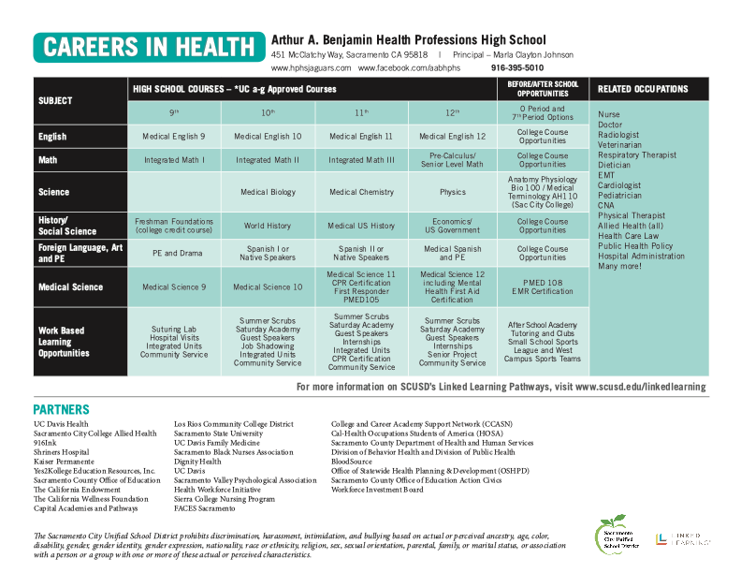

Slide 51
How We Know It’s Working: Students in Certified Pathways
20 percent more pathway students report improved communication and teamwork skills
Accrue more credits—equivalent of more than two courses
Are more likely to graduate (5-9 percentage points); less likely to dropout
Significant achievement gains for lowest achieving students
Enroll and persist in postsecondary programs at equal or higher rates (+ 12 percent for African Americans)
Earn as much as $2,500 more annually in the eight years after high school graduation, equivalent to bump associated with an AA degree

